Slide 1
Machine Learning Deploy App with Flask
Fajar Kurniawan 2001533017

Slide 2
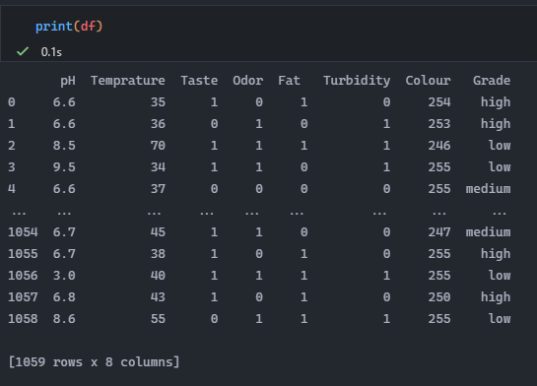
Dataset

Slide 3
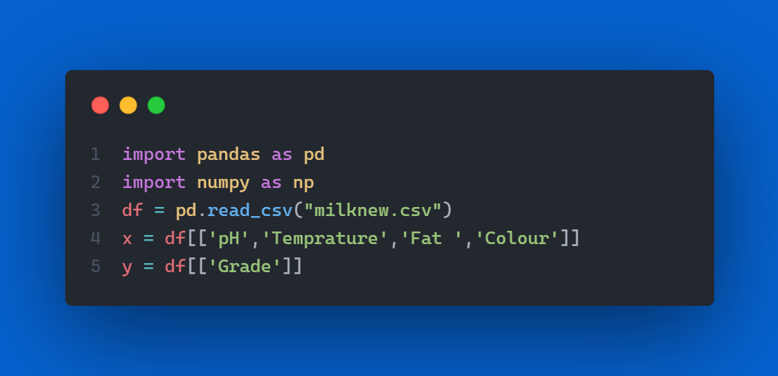
Design model

Slide 4
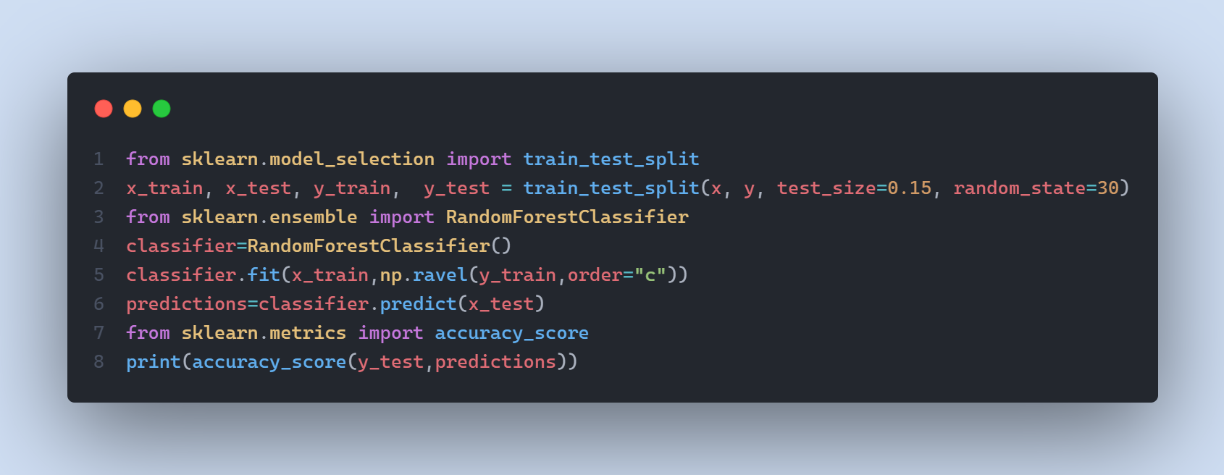
Design model

Slide 5
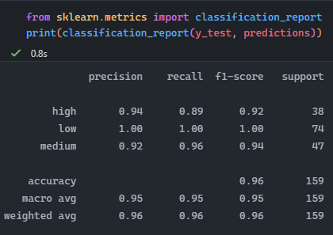
Accuracy

Slide 6
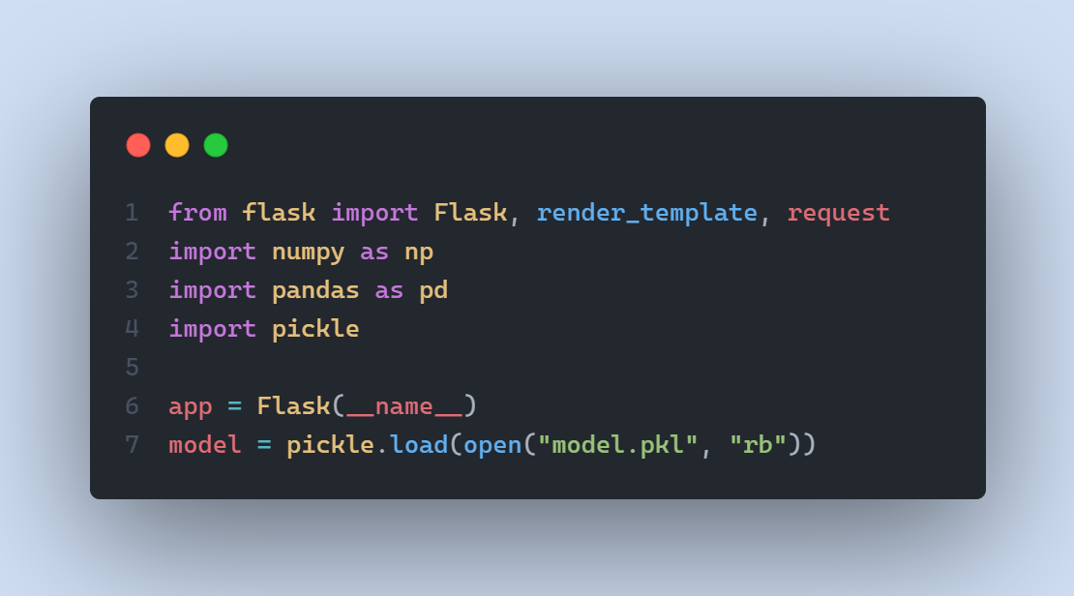
Flask

Slide 7
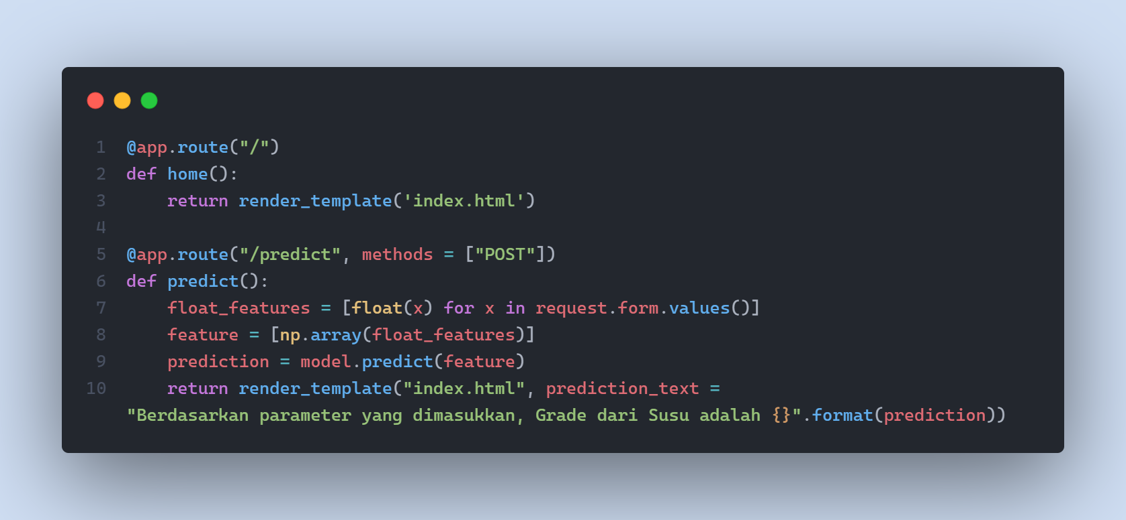
Flask

Slide 8
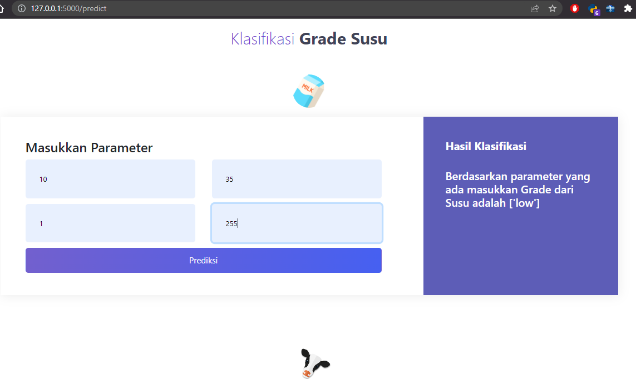
Tampilan Web

